Slide 1

Parsons ChatOps Rapid Prototype
Jason Cook – Director Specialist, Global Black Belt
Developer Productivity & Platform Engineering

Slide 2
Logistics
Wifi
Bathrooms
Breaks
Parking
Notes:
But first – a little bit about myself…

Slide 3
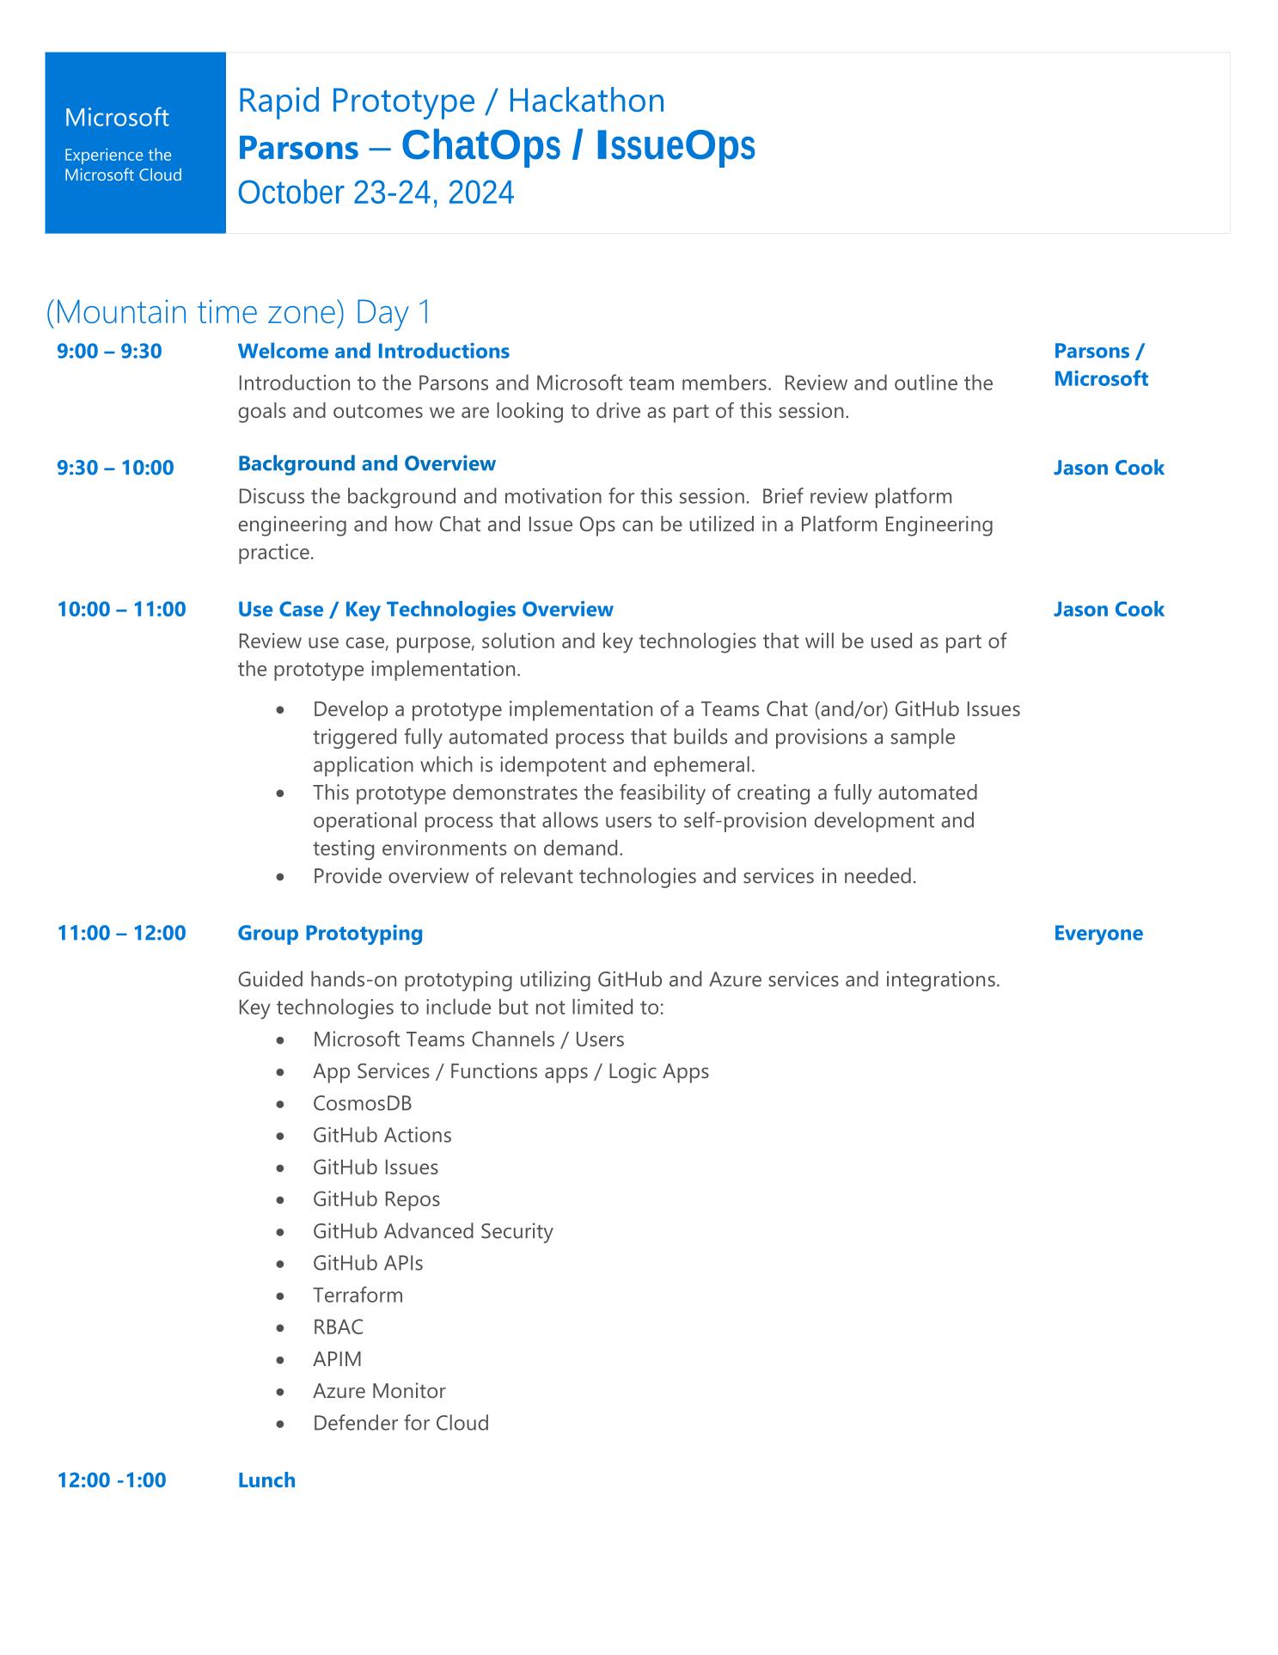

Slide 4
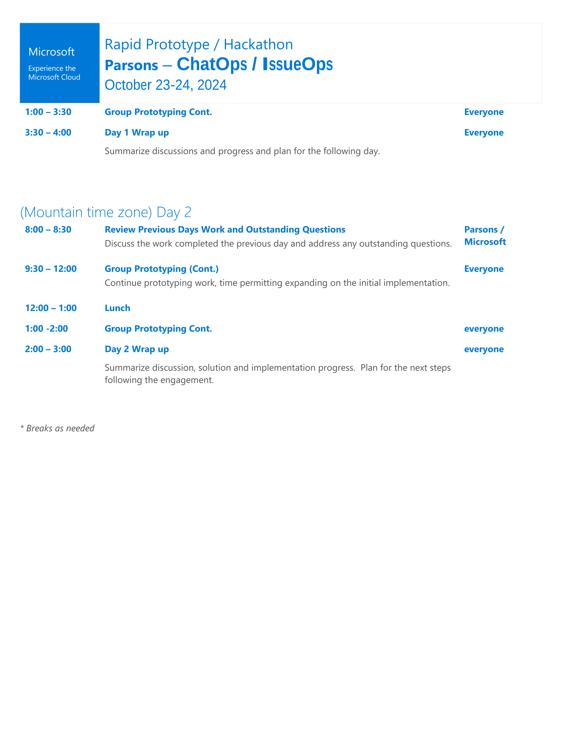

Slide 5
Platform Engineering
What is it and why do we need it?
Accelerate Parson’s Product Modernization
Reduce cloud costs
Three Pillars
Develop / Collaborate
Preproduction
Deploy and Observe

Slide 6
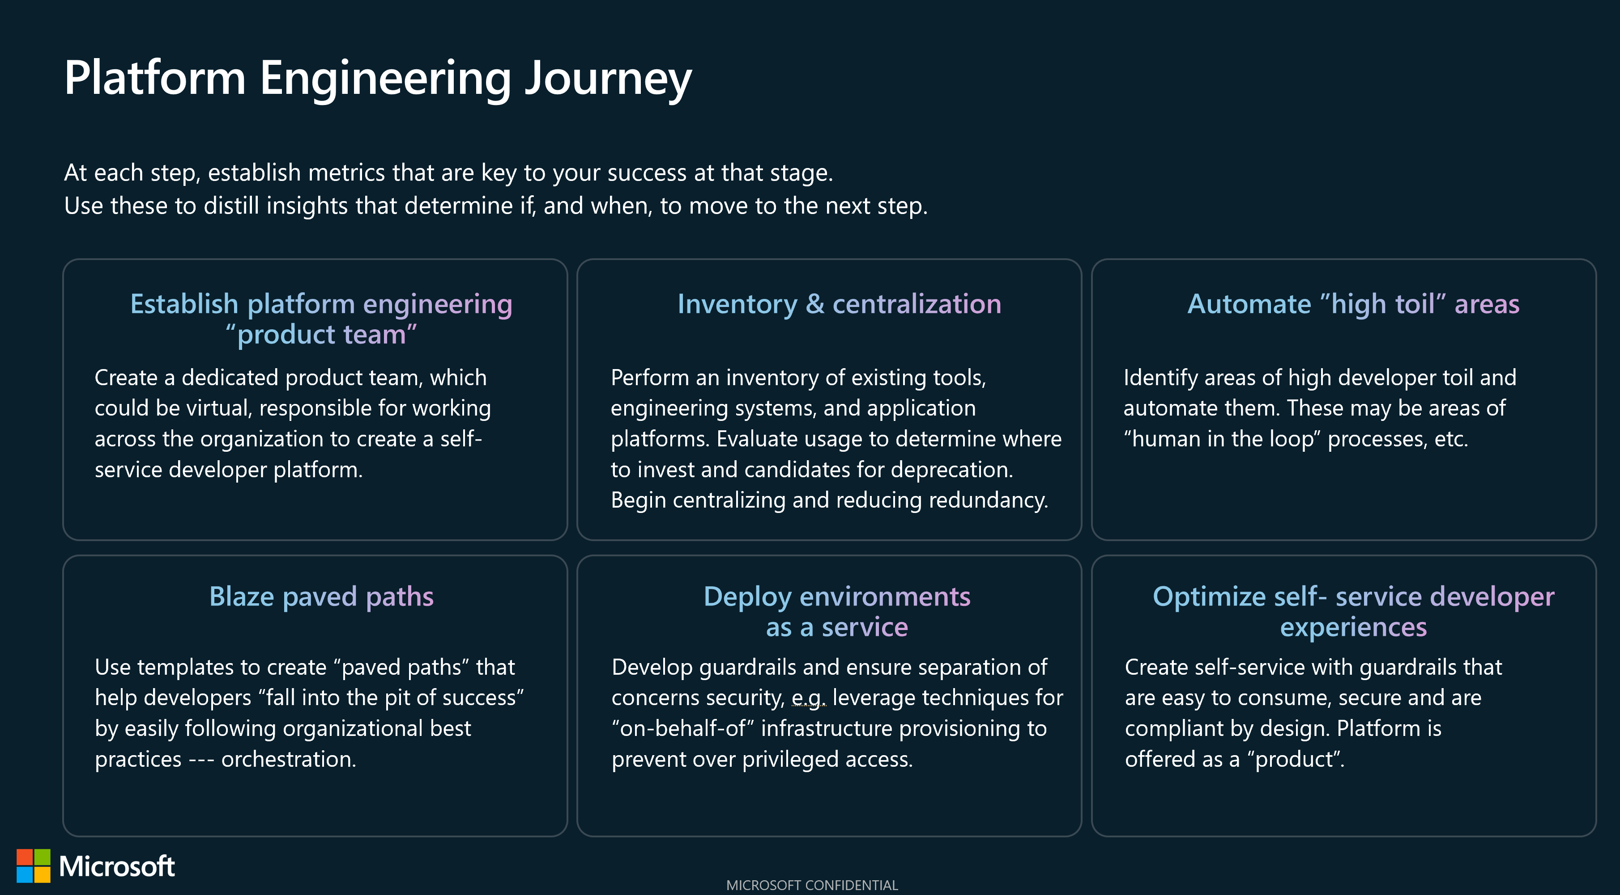

Slide 7

Polishing a diamond

Slide 8





Copilot
Collaboration
Pull requests
Projects
Issues
Discussions
Merge queue
Search
Productivity
CI/CD with Actions
Automation
Copilot
Codespaces
Runners
npm
Mobile
Security
Advanced Security
Secret scanning
Code scanning
Security overview
Supply chain
Dependabot
Scale
Integrations & APIs
100M+ developers
Source code management

Slide 9
Components
Infra
Resource Group
CosmosDB
Storage act.
Defender for cloud / DevOps Security
Teams integration (Chat Bot)
Channel
User
Logic apps (automated workflows)
Provisioning
Provisioned responder
Deprovisioning
Deprovisioned responder
Environment reaper
Function App / App Service / Demo App
MS Graph API
DevBox
GitHub Org
GH user
GH repo
GH actions (API) workflow (CI/CD)
Provision
Deprovision
CodeQL
GitHub Advanced Security
Codespaces
GitHub Copilot
Terraform

Slide 10
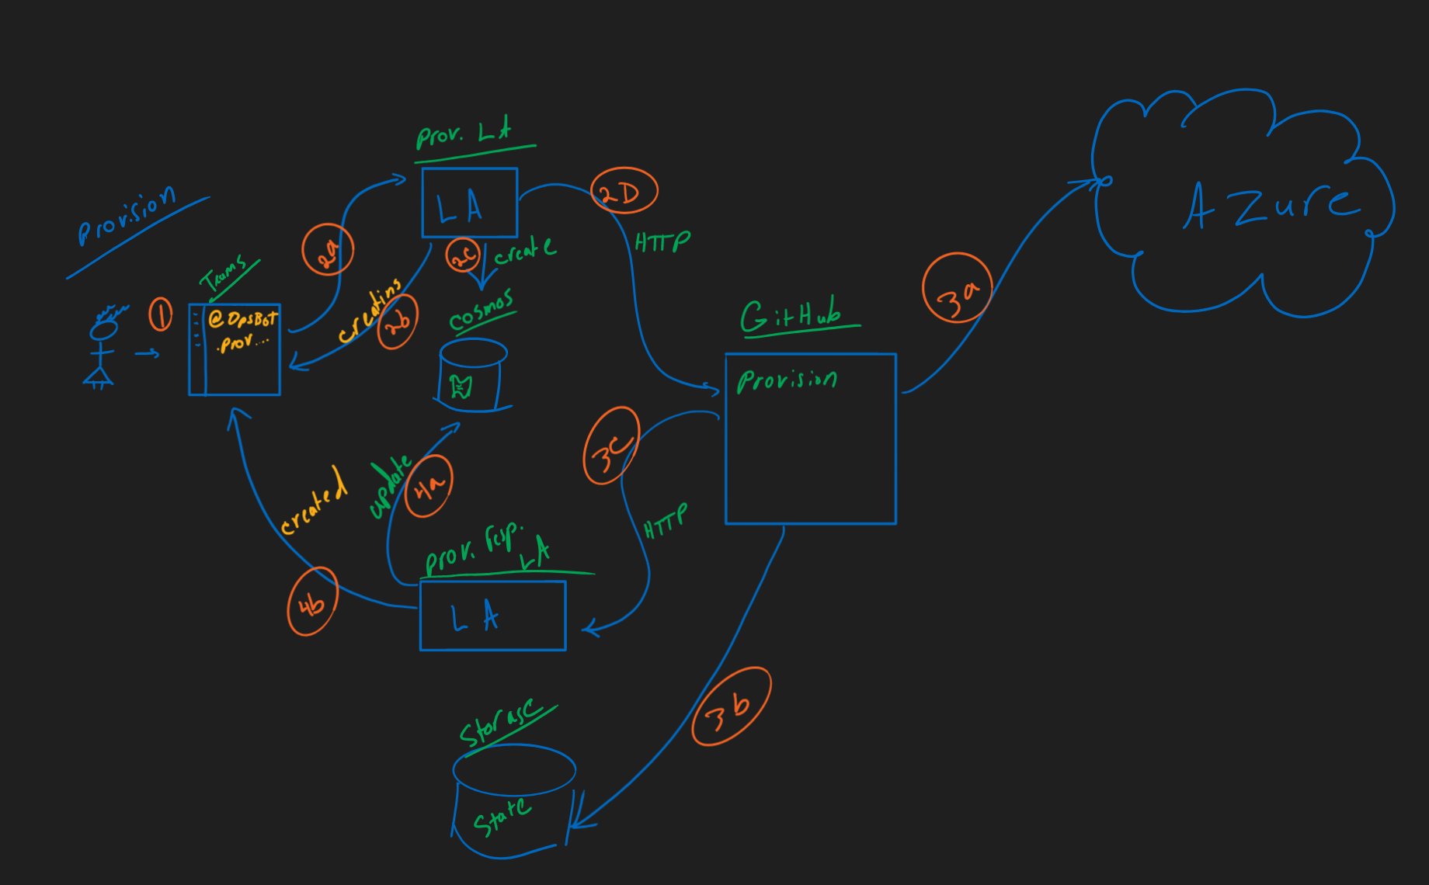
Provisioning

Slide 11








Provisioning
Workload Deployed to Azure
Provision Logic App
Teams User Trigger
GitHub Actions Workflow
Cosmos DB for Environment State Persistence
Provision Response Logic App
Storage Account for Terraform State

Slide 12
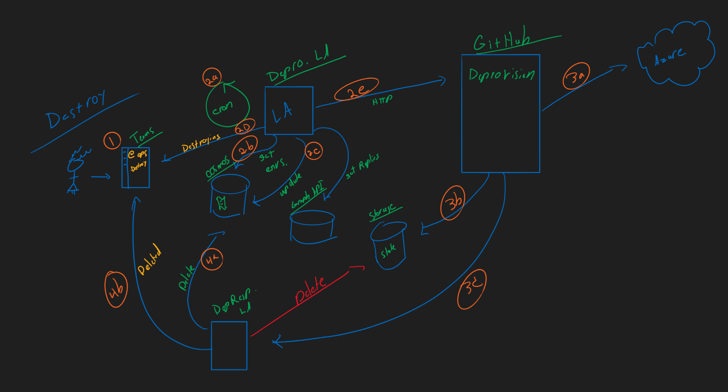
Deprovisioning

Slide 13
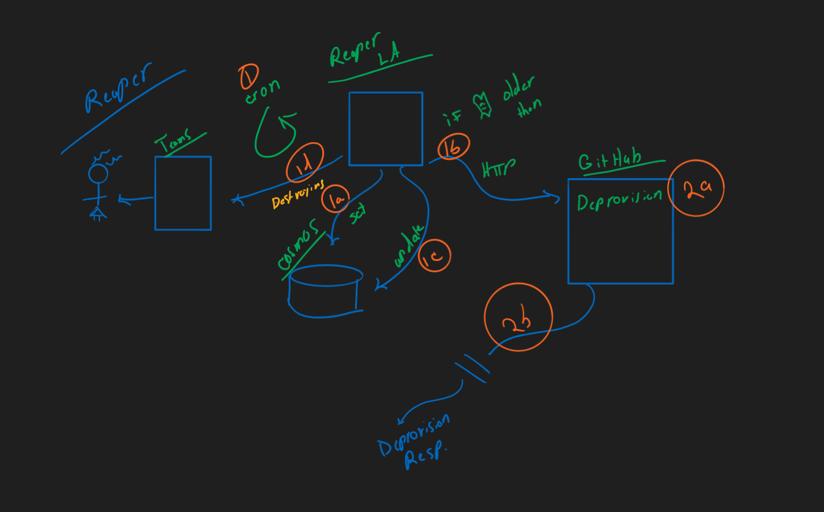
Reaper

Slide 14
Infra
Infra
Resource Group
CosmosDB
Storage act
Defender for cloud / DevOps Security

Slide 15
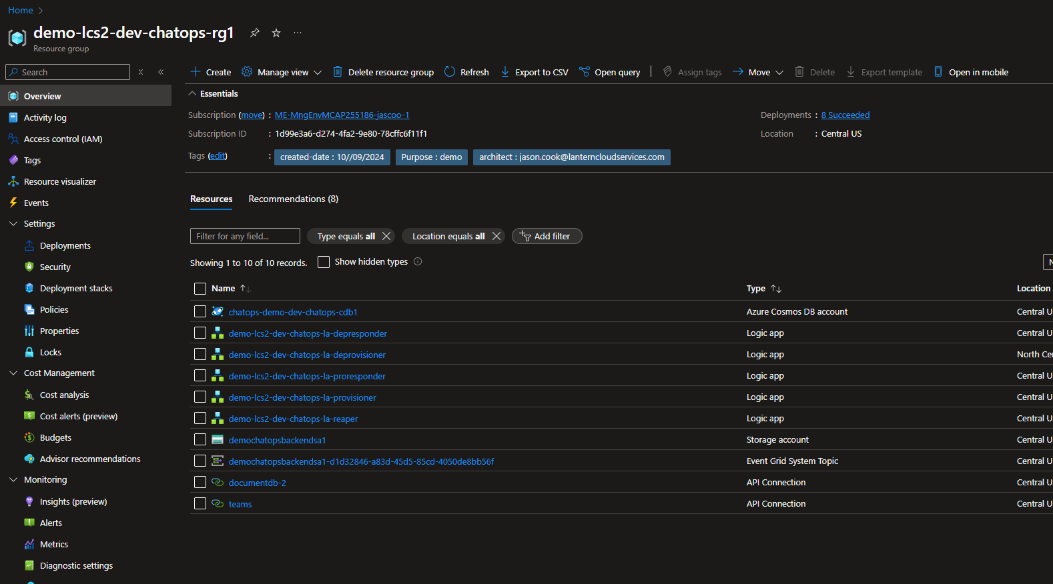
Operational RG

Slide 16
RBAC for Cosmos
RBAC
$resourceGroupName = "demo-lcs2-dev-chatops-rg1"
$accountName = "chatops-demo-dev-chatops-cdb1"
$roleDefinitionId = "/subscriptions/d16ac254-**************/resourceGroups/demo-lcs-appdev-core-rg1/providers/Microsoft.DocumentDB/databaseAccounts/demo-lcs-appdev-core-cdb1/sqlRoleDefinitions/00000000-0000-0000-0000-000000000002"
$principalId = "f41d53ef-********************"
New-AzCosmosDBSqlRoleAssignment -AccountName $accountName `
-ResourceGroupName $resourceGroupName `
-RoleDefinitionId $roleDefinitionId `
-Scope "/" `
-PrincipalId $principalId

Slide 17
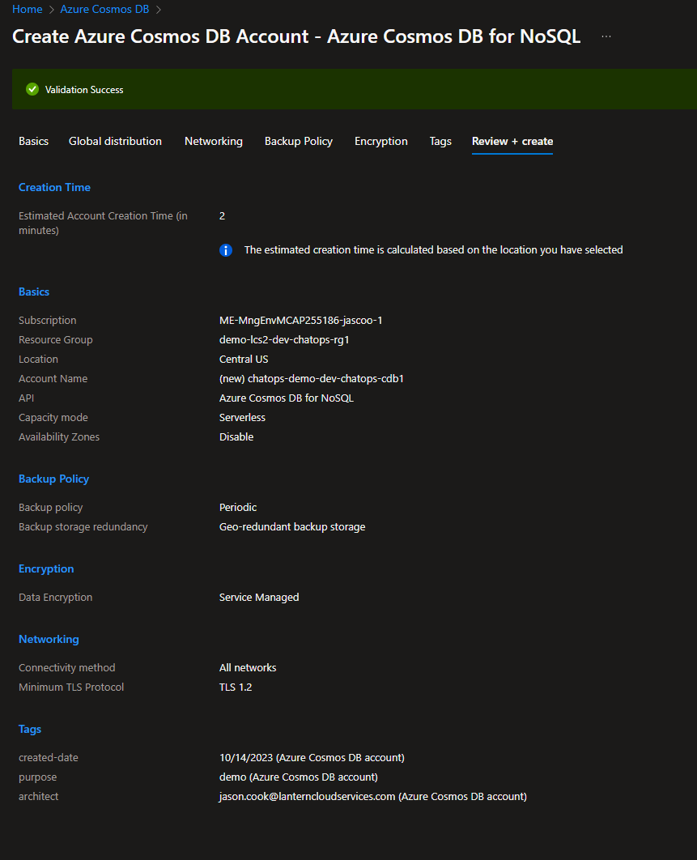
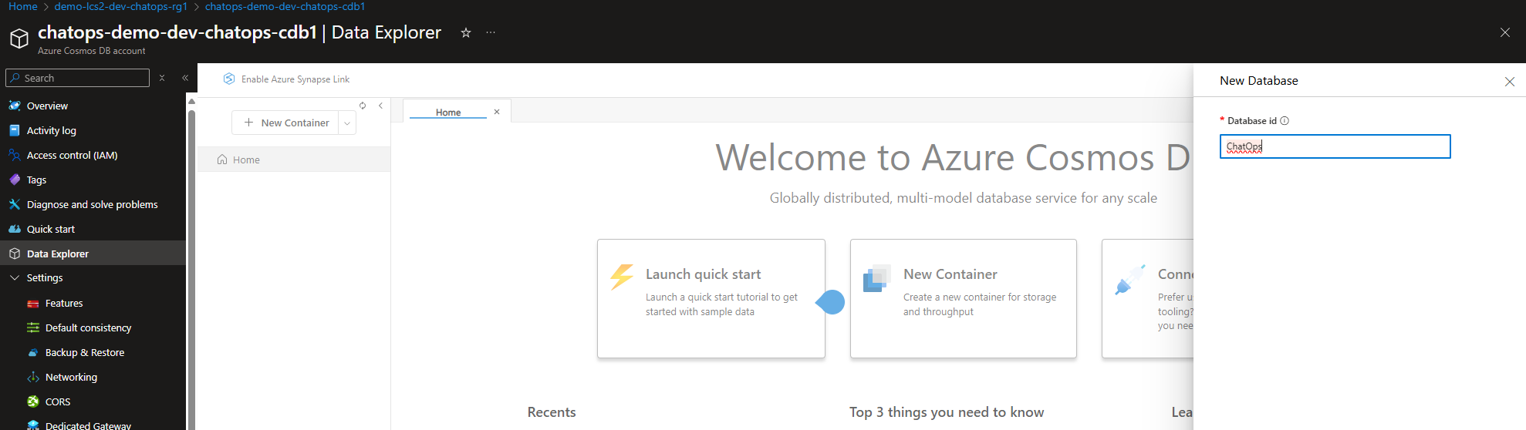
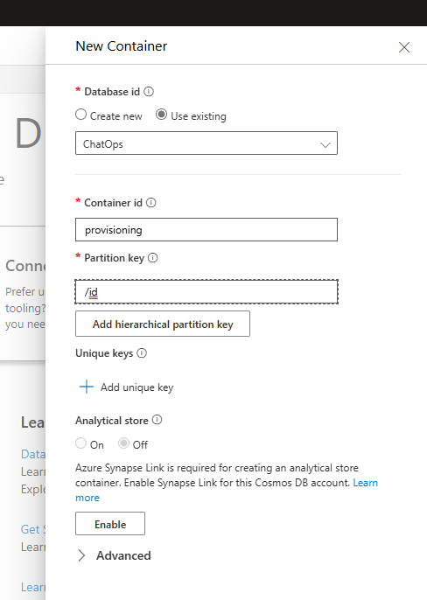
Operational Cosmos
New DB
New Container

Slide 18
Operational Cosmos
New DB
New Container

Slide 19
Operational Cosmos
Example datapoint
{
"status": "static",
"id": "silverFish",
"user": “John Doe",
"userId": "f41d53ef-011e-**************",
"messageId": "1729089998758",
"msg": "output msg",
"timestamp": "2024-10-16T14:52:14.4022736Z"
}

Slide 20
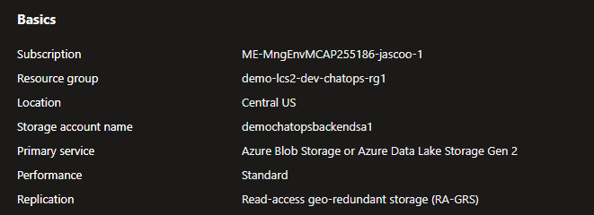
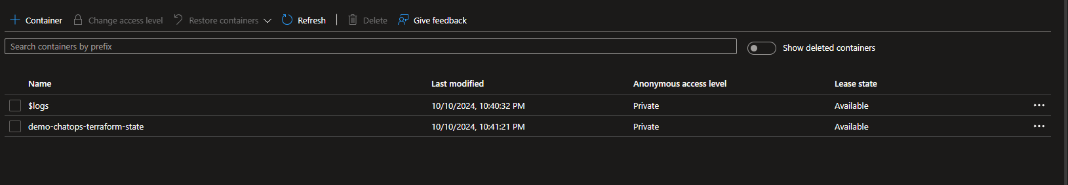
Operational Storage Act.
Container

Slide 21
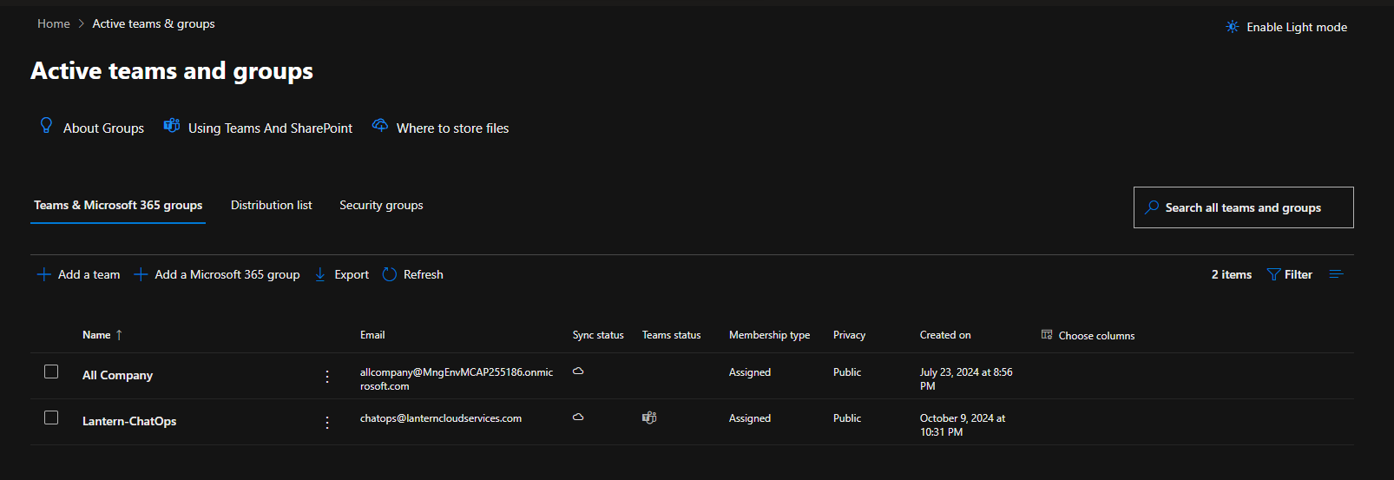
Teams Integration
ChatOps Channel

Slide 22
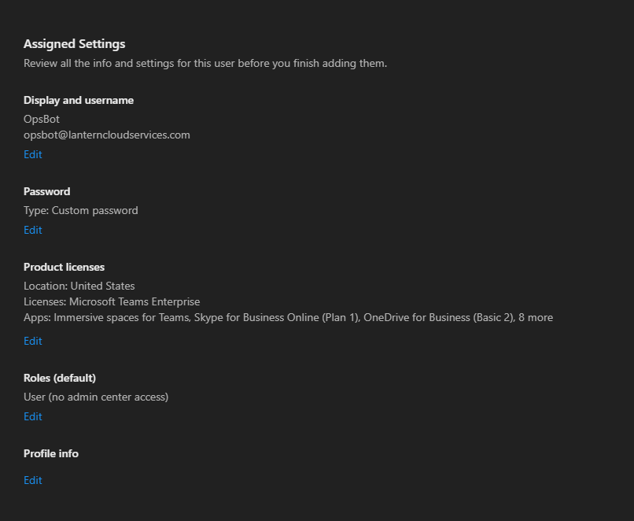
Teams Integration
OpsBot User

Slide 23
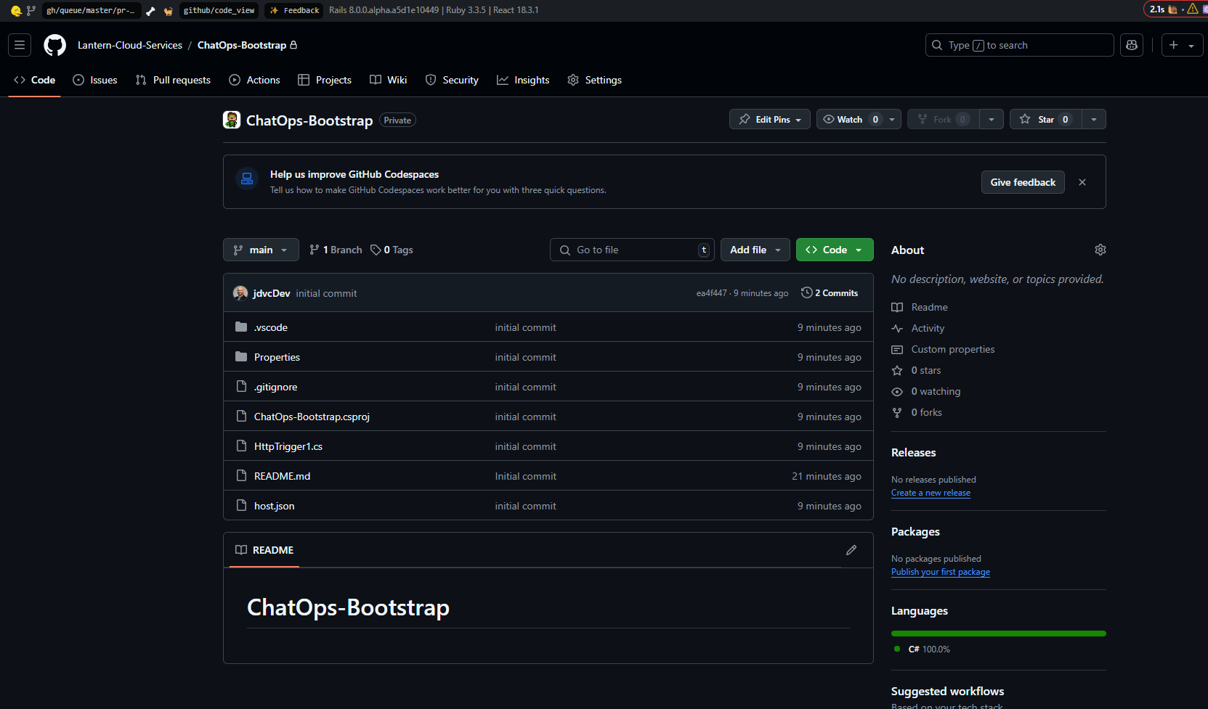
GitHub Project
Repository

Slide 24
GitHub Project
Service Principal for GH action
az ad sp create-for-rbac --name chatopsgh
{
"appId": "c01e6c00-d78f-41d0-892e-4008403693f1",
"displayName": "chatopsgh",
"password": "",
"tenant": "8d23ee13-f065-4c3e-*****************"
}
GH Secrets
AZURE_AD_CLIENT_ID – c01e6c00-d78f-41d0-892e-4008403693f1
AZURE_AD_CLIENT_SECRET –
AZURE_AD_TENANT_ID – 8d23ee13-f065-***************
AZURE_SUBSCRIPTION_ID – 1d99e3a6-d274-4fa2-9e80-78cffc6f11f1

Slide 25
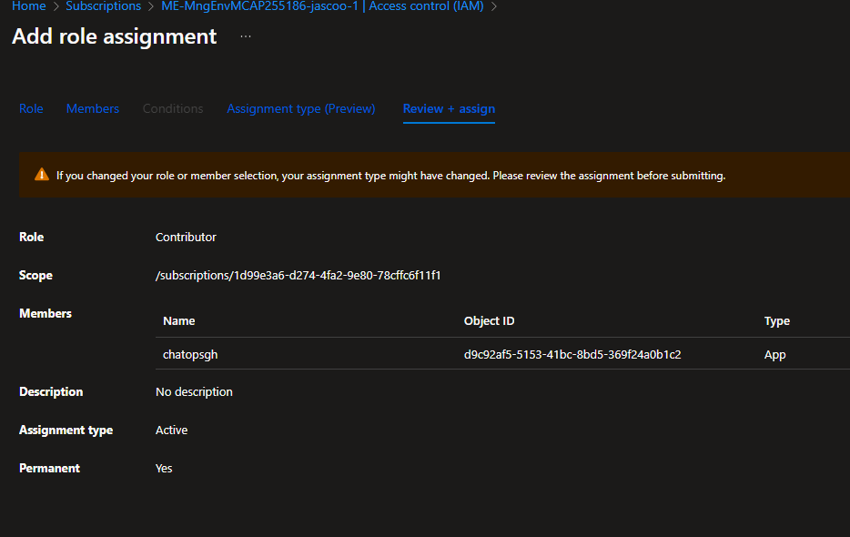
GitHub Project
Contributor access for Principal

Slide 26
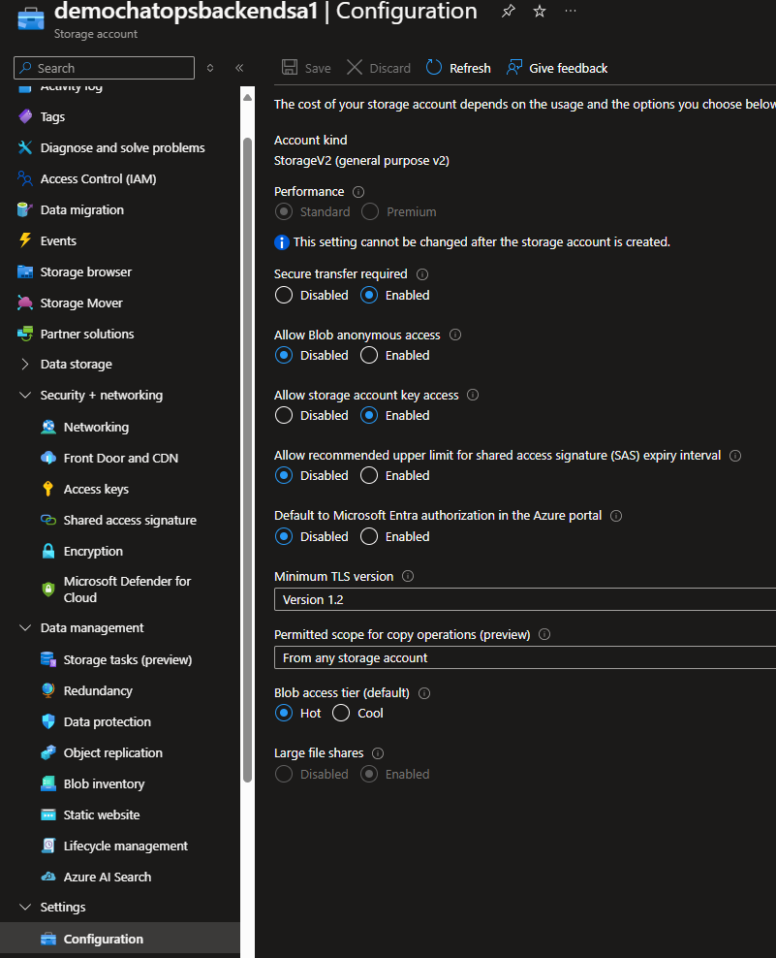
GitHub Project
Key Based Access for Storage Act. (Not a Best Practice)

Slide 27
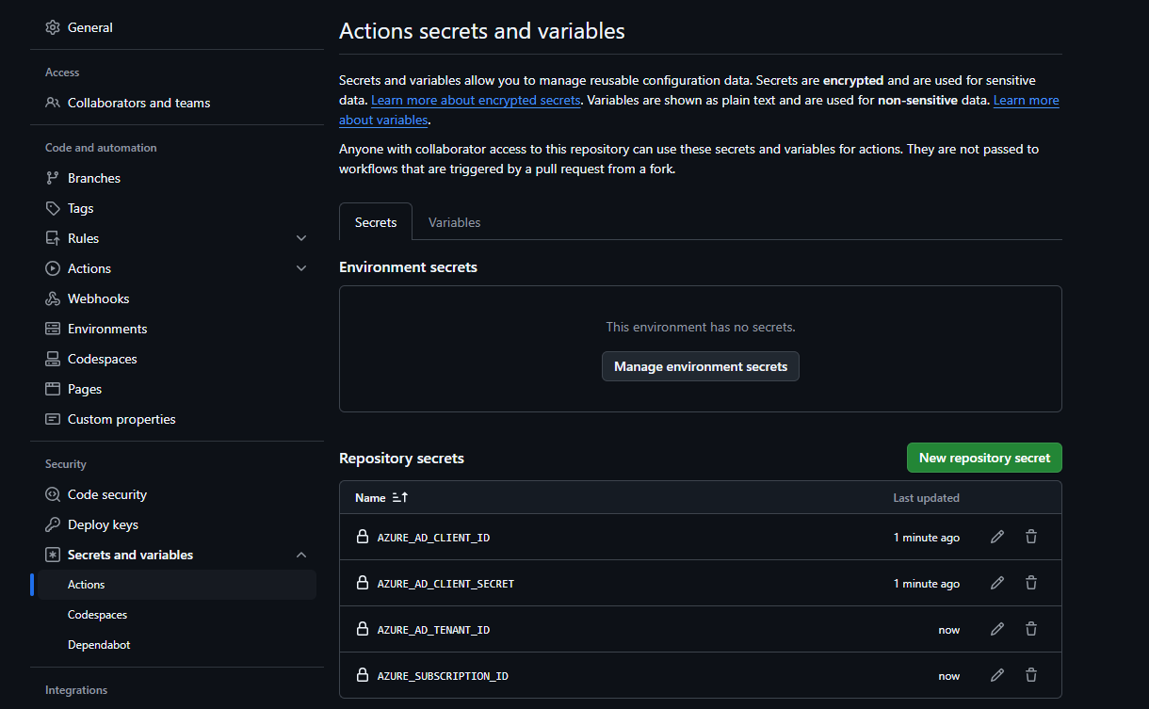
GitHub Project
Store Creds in Project Settings

Slide 28
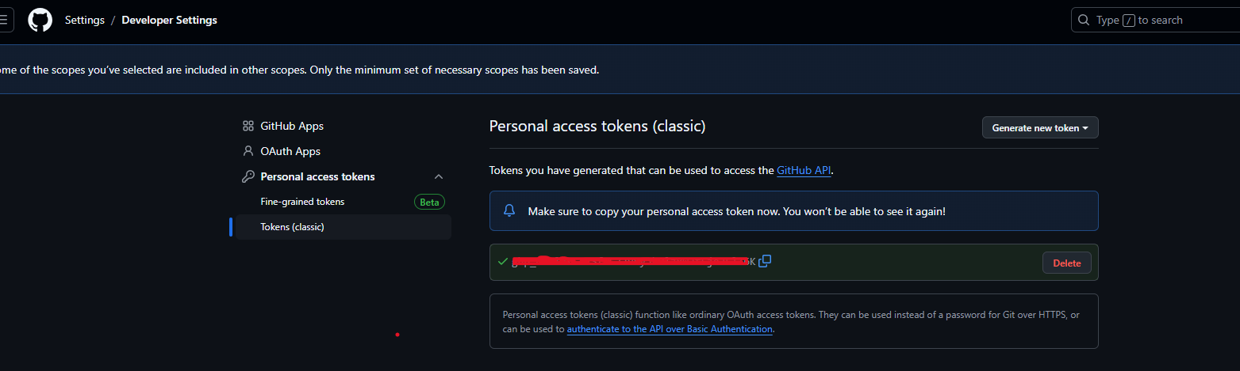
GitHub Project
OpsBot GH User and Classic Token

Slide 29
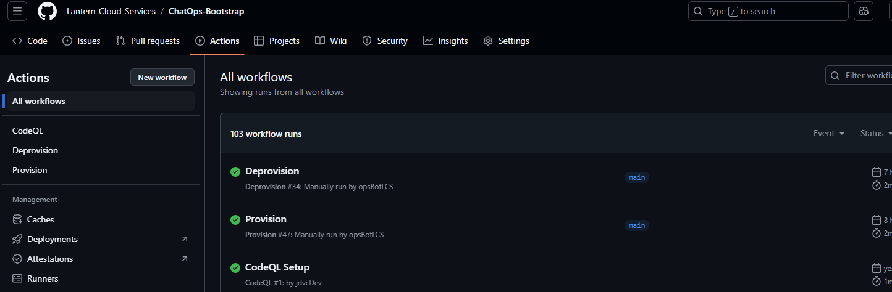
GitHub Project
Actions Workflow
ChatOps-Bootstrap/.github/workflows at main · Lantern-Cloud-Services/ChatOps-Bootstrap

Slide 30
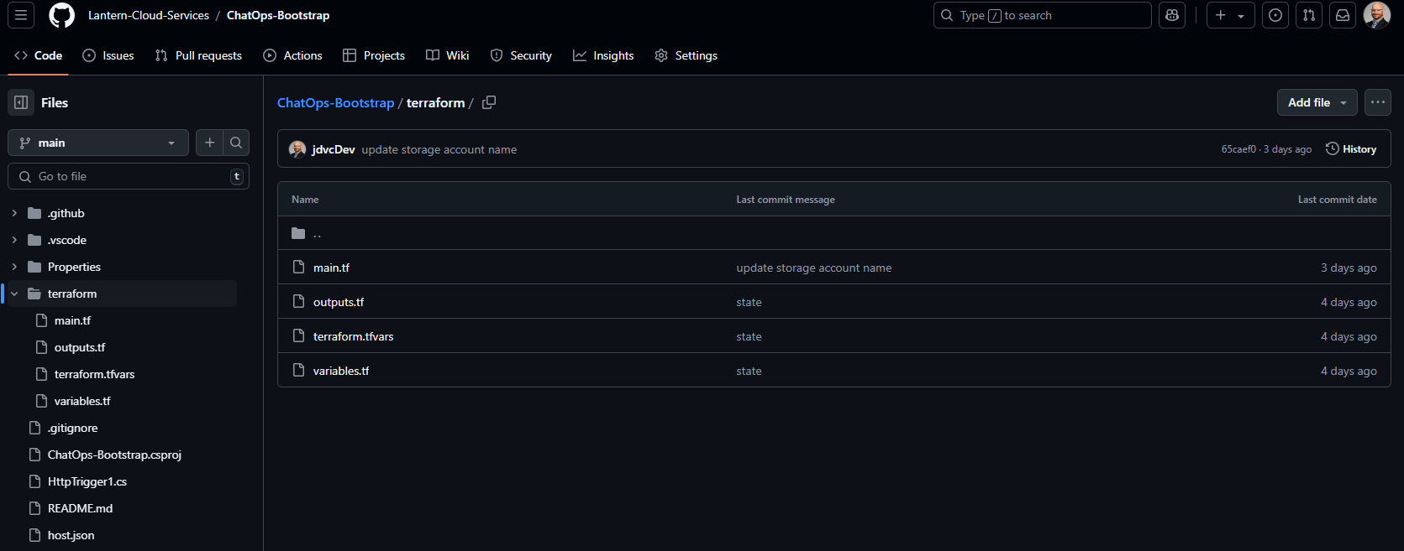
GitHub Project
Terraform
ChatOps-Bootstrap/terraform at main · Lantern-Cloud-Services/ChatOps-Bootstrap

Slide 31
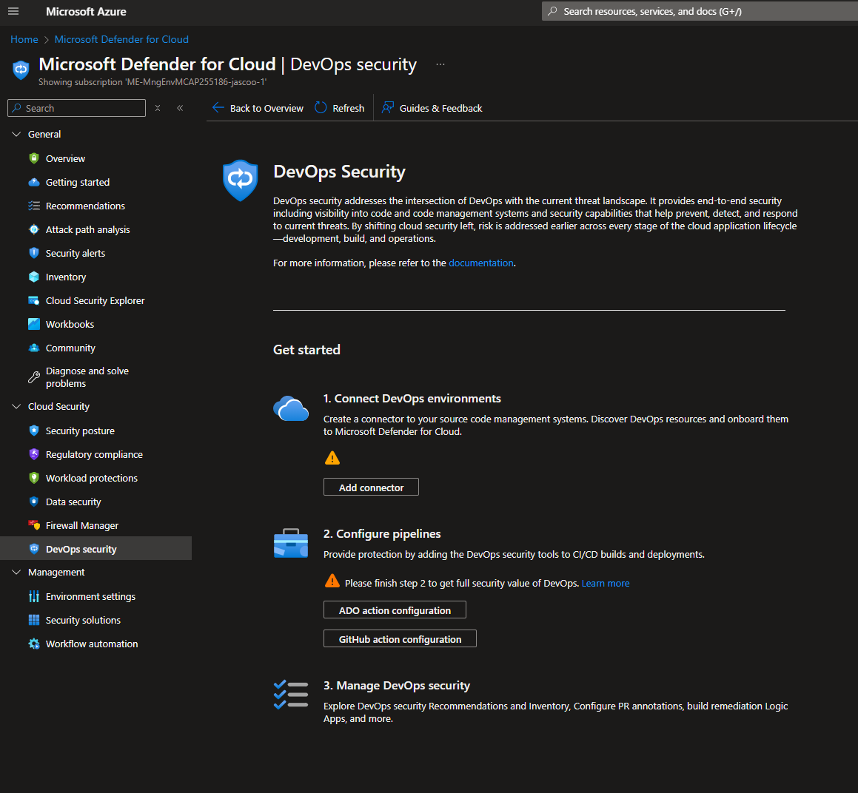
Defender For Cloud
DevOps Security

Slide 32
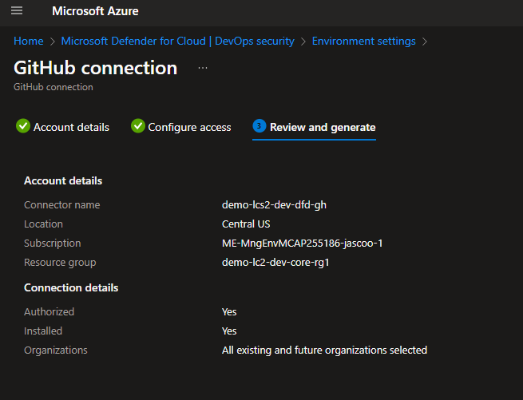
Defender For Cloud
GitHub Connection

Slide 33
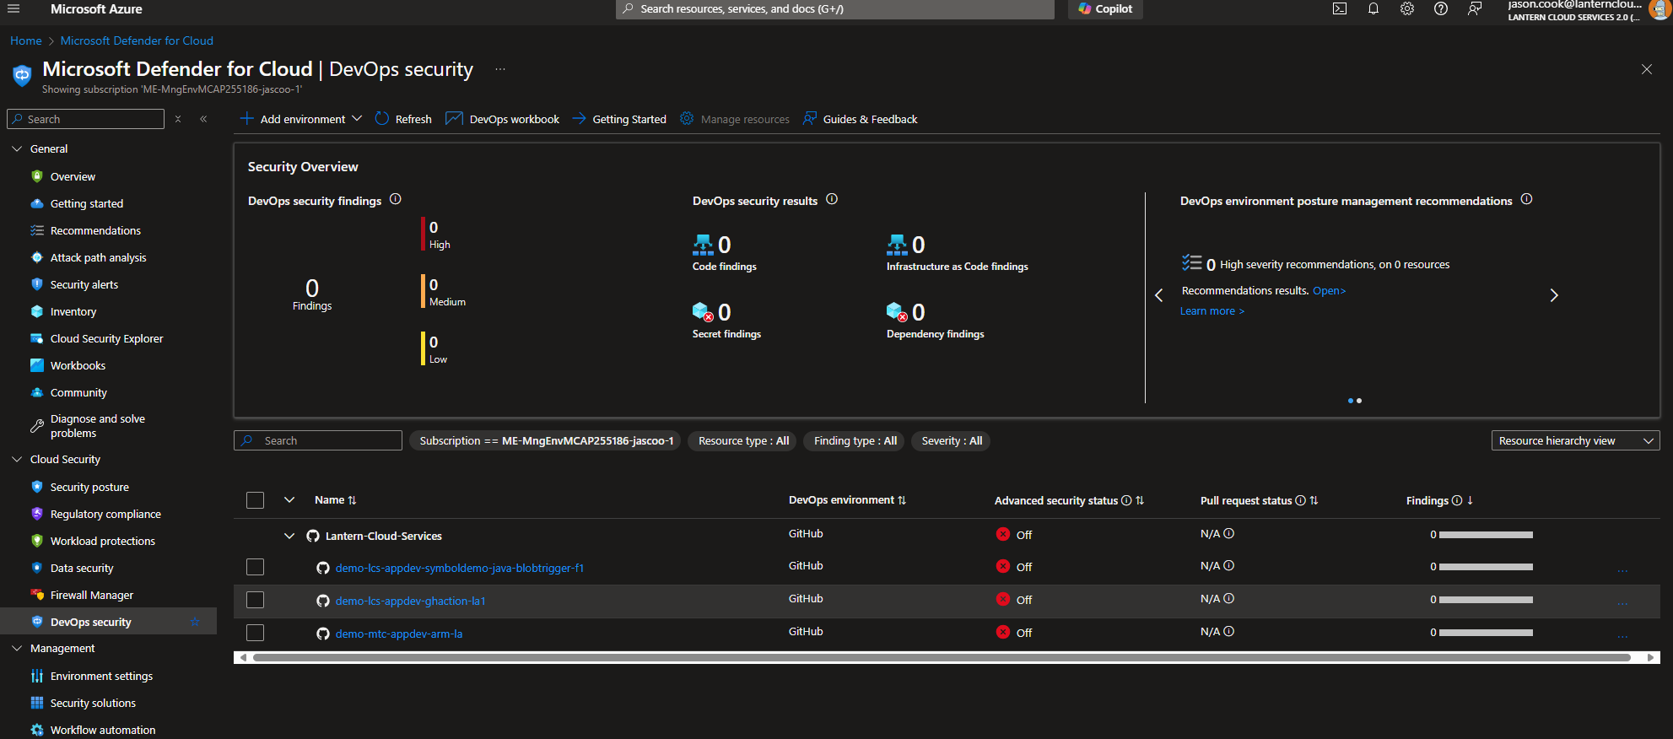
Defender For Cloud
GitHub Connection

Slide 34
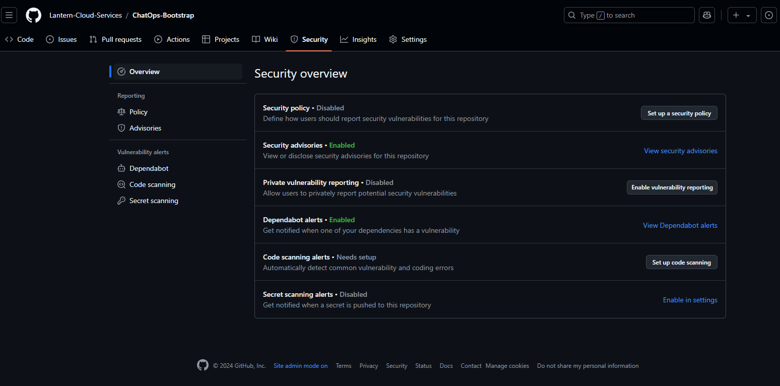
Defender For Cloud
Enable GHAS

Slide 35
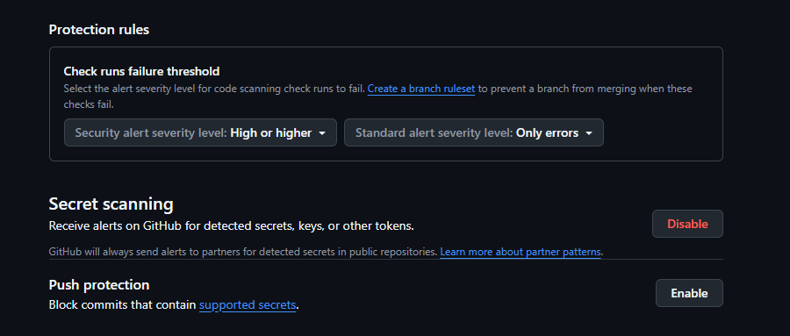
Defender For Cloud
Enable GHAS

Slide 36
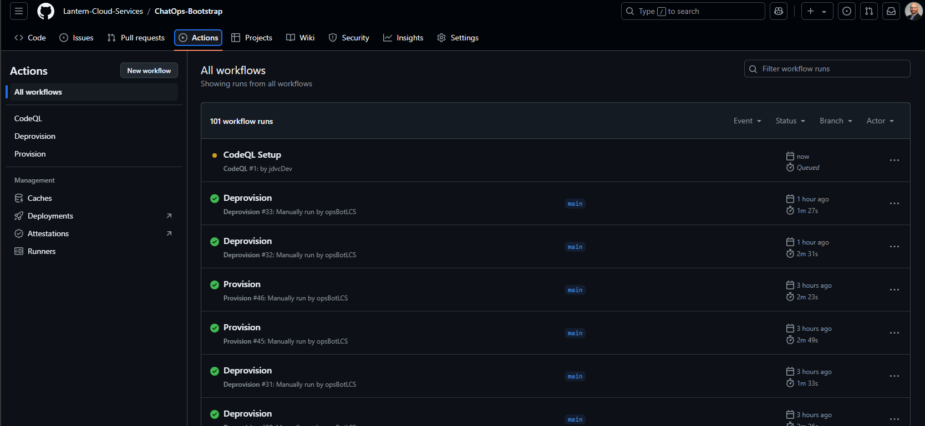
Defender For Cloud
Enable GHAS

Slide 37
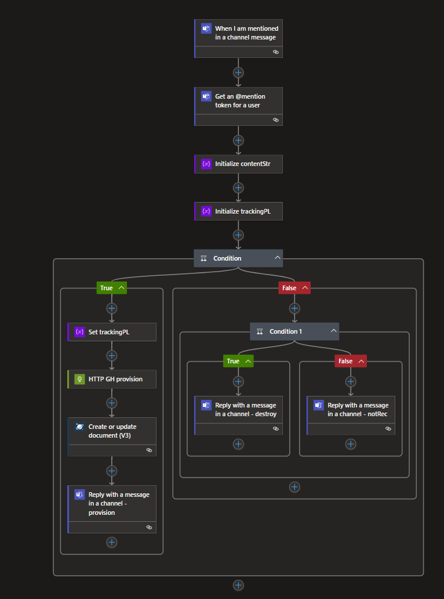
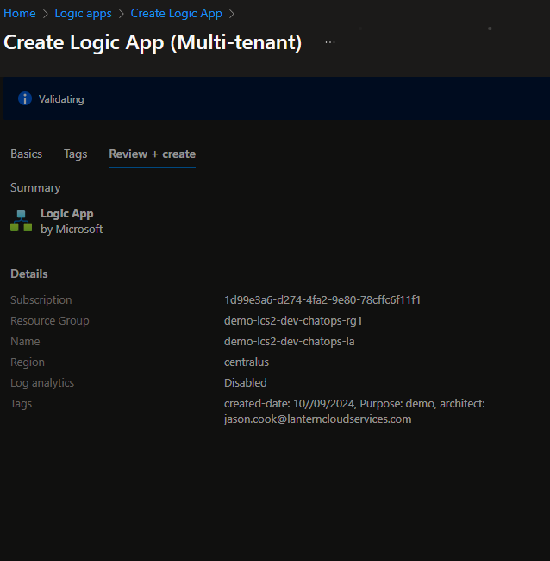
Teams Provision Watcher Logic App
@Mention Trigger

Slide 38
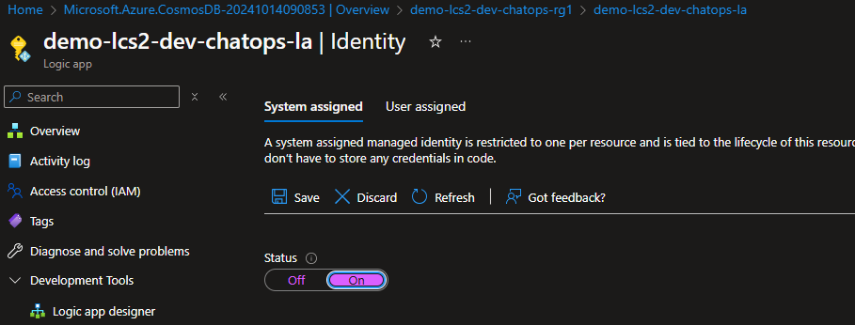
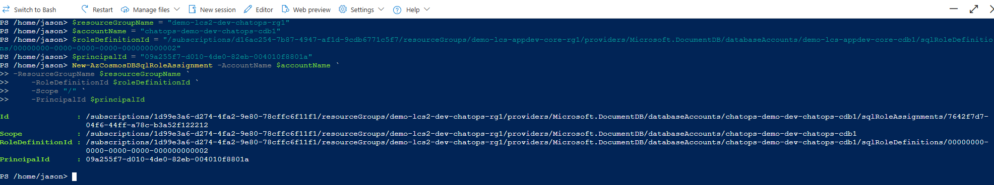
Teams Provision Watcher Logic App
RBAC for Cosmos

Slide 39
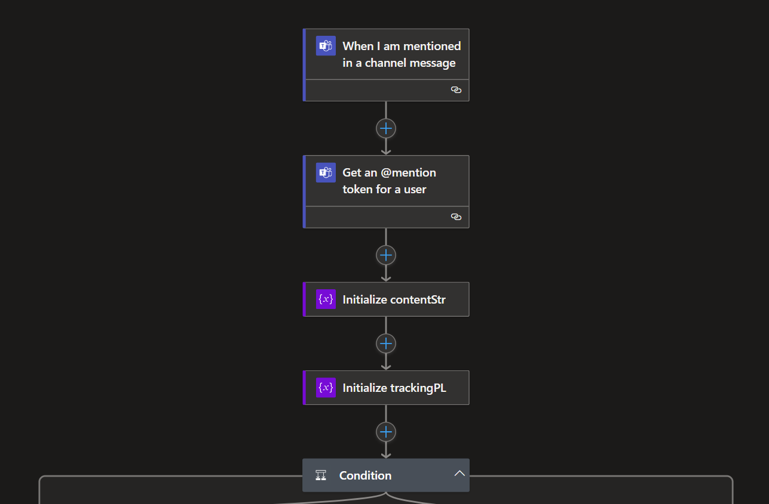
Teams Provision Watcher Logic App
Flow

Slide 40
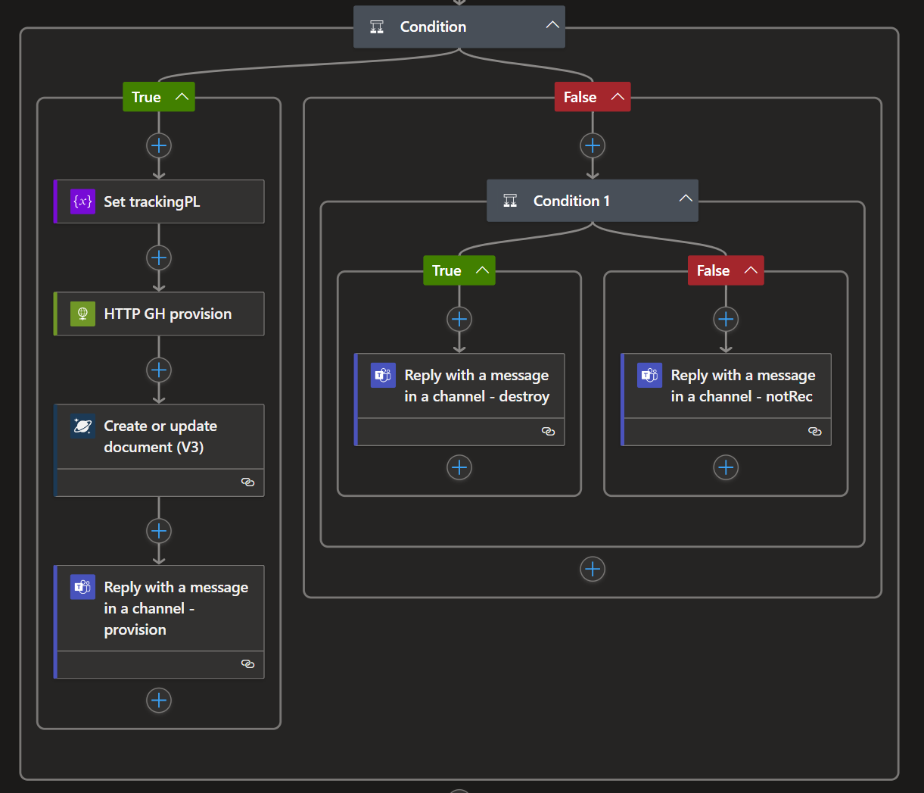
Teams Provision Watcher Logic App
Flow
Notes:
{
"status": "provisioned",
"id": "1728965331102",
"user": "Jason Cook",
"userId": "f41d53ef-011e-4bba-8ecc-c77fd90b08d1",
"messageId": "1728965331102",
"msg": "output msg",
"timestamp": "2024-10-15T04:11:15.5636782Z"
}

Slide 41
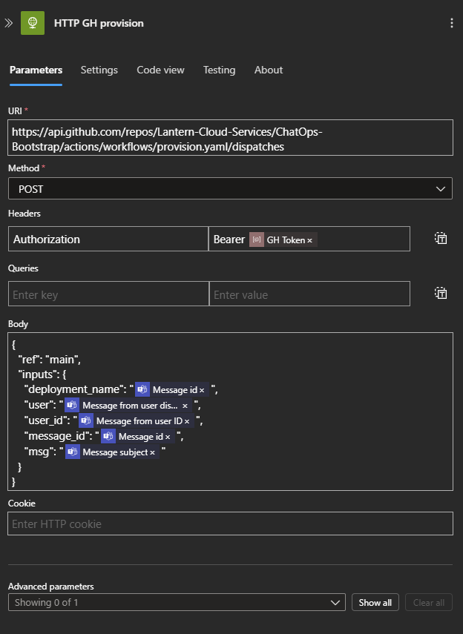
Teams Provision Watcher Logic App
Flow – GH provision call
Store GH classic token
API payload
{
"ref": "main",
"inputs": {
"deployment_name": "",
"user": "",
"user_id": "",
"message_id": "",
"msg": ""
}
}
Notes:
/repos/{owner}/{repo}/actions/workflows/{workflow_id}/dispatches
curl -L \
-X POST \
-H "Accept: application/vnd.github+json" \
-H "Authorization: Bearer <YOUR-TOKEN>" \
-H "X-GitHub-Api-Version: 2022-11-28" \
https://api.github.com/repos/OWNER/REPO/actions/workflows/WORKFLOW_ID/dispatches \
-d '{"ref":"topic-branch","inputs":{"name":"Mona the Octocat","home":"San Francisco, CA"}}'

Slide 42
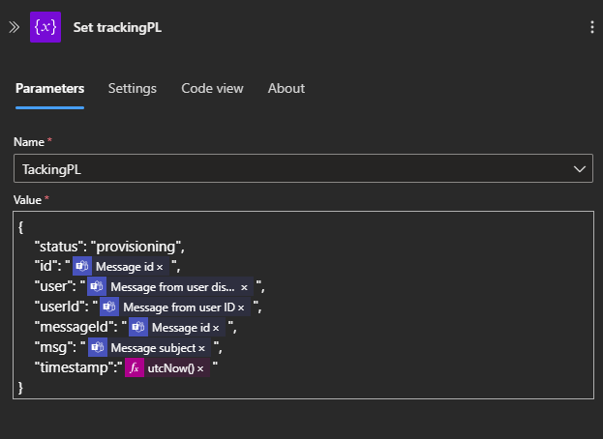
Teams Provision Watcher Logic App
Flow – Insert tracking payload
{
"status": "provisioned",
"id": "1728965331102",
"user": “Jon Doe",
"userId": "f41d53ef-011e-*****************",
"messageId": "1728965331102",
"msg": "output msg",
"timestamp": "2024-10-15T04:11:15.5636782Z"
}
API payload

Slide 43
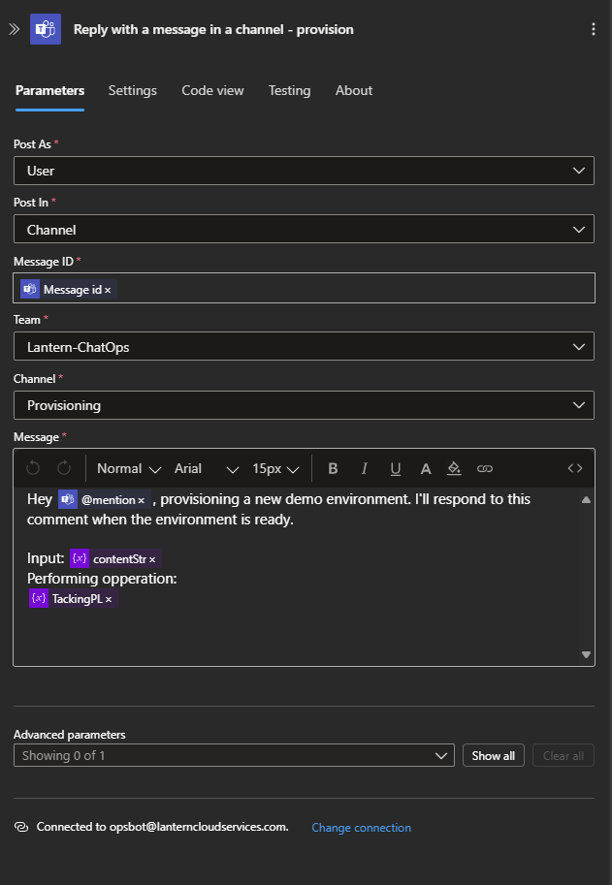
Teams Provision Watcher Logic App
Flow – @ reply

Slide 44
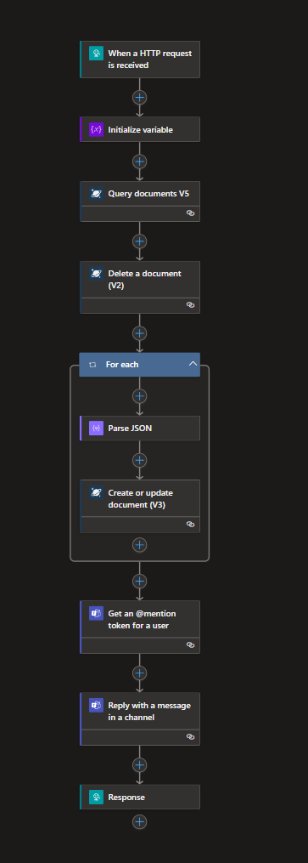
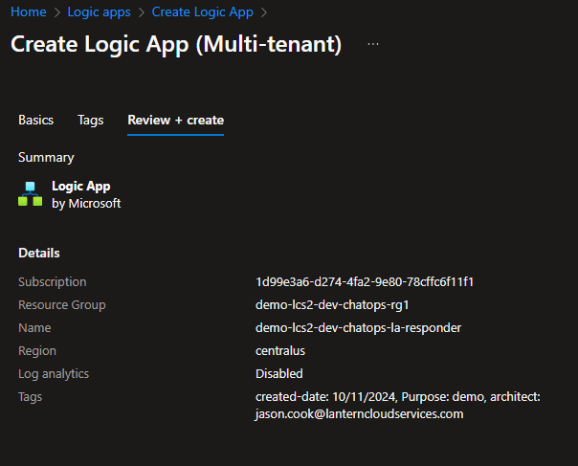
Teams Provision Responder Logic App
HTTP Trigger

Slide 45
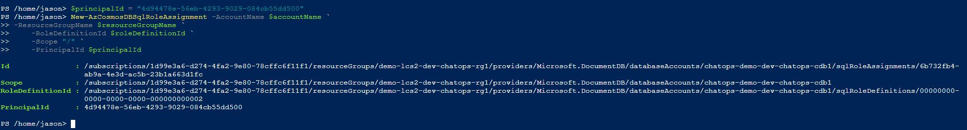
Teams Provision Responder Logic App
RBAC process as previous

Slide 46
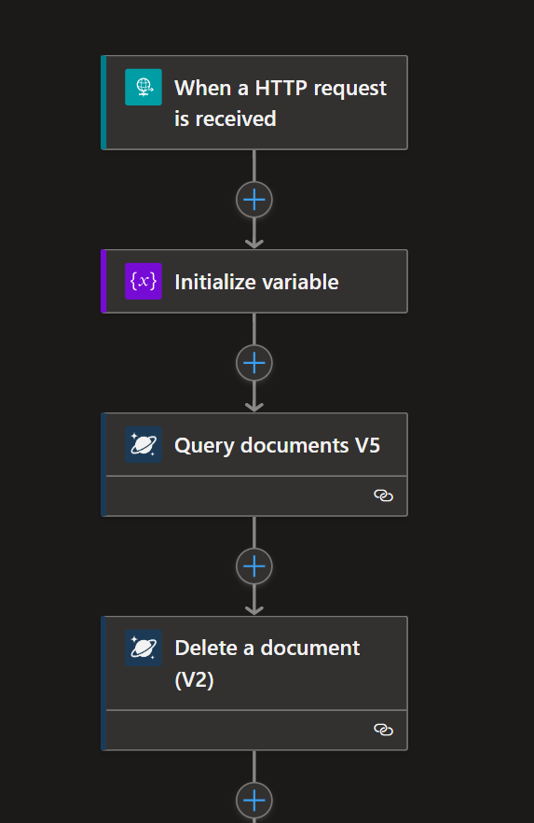
Teams Provision Responder Logic App
Flow - Trigger
Example payload
{
"status":"provisioned",
"id":"${{ inputs.deployment_name }}",
"resourceGroup":"chatops-demo-dev-rg-${{inputs.deployment_name }}",
"user":"${{ inputs.user }}",
"userId":"${{ inputs.user_id }}",
"messageId":"${{ inputs.message_id }}",
"msg":"${{ inputs.msg }}"
}

Slide 47
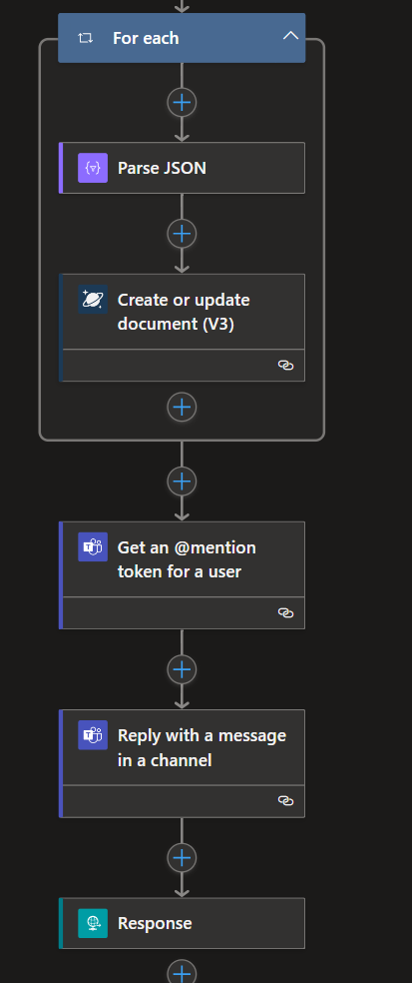
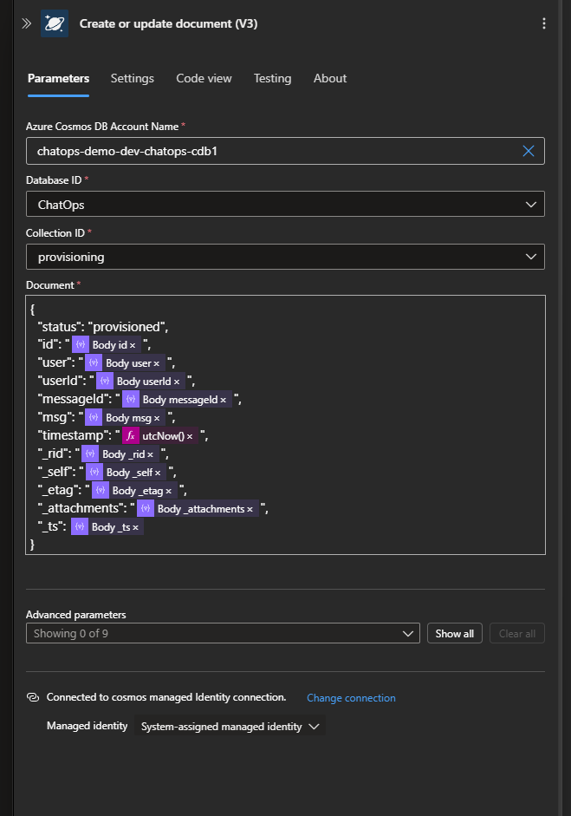
Teams Provision Responder Logic App
Flow – Update document to provisioned status

Slide 48
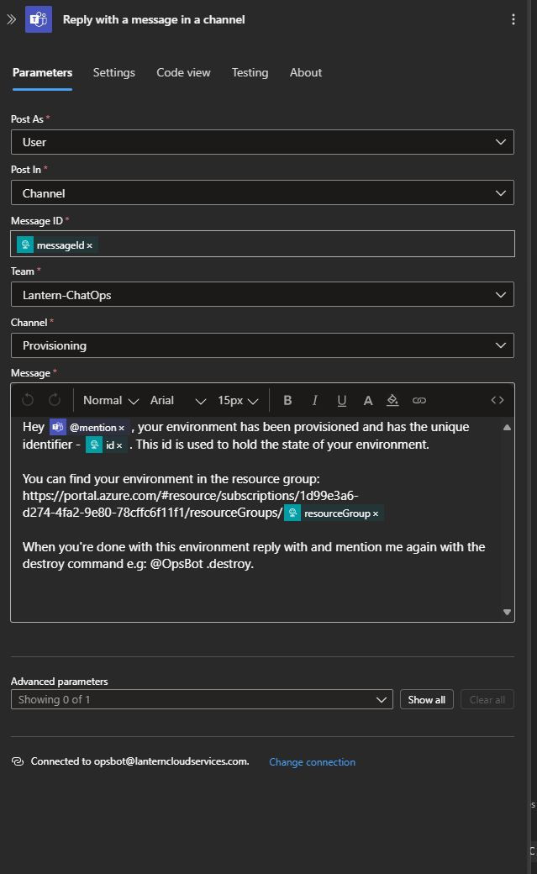
Teams Provision Responder Logic App
Flow – Reply to user

Slide 49
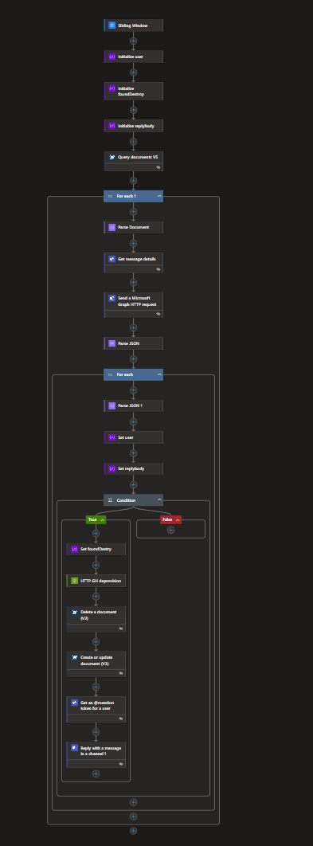
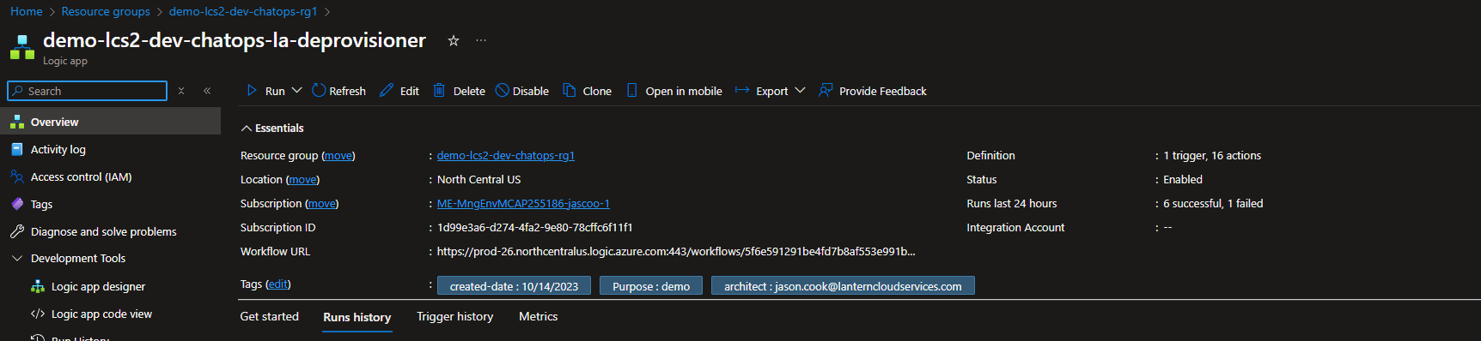
Teams Destroy Watcher Logic App
Cron Trigger
RBAC for Cosmos - set up as before

Slide 50
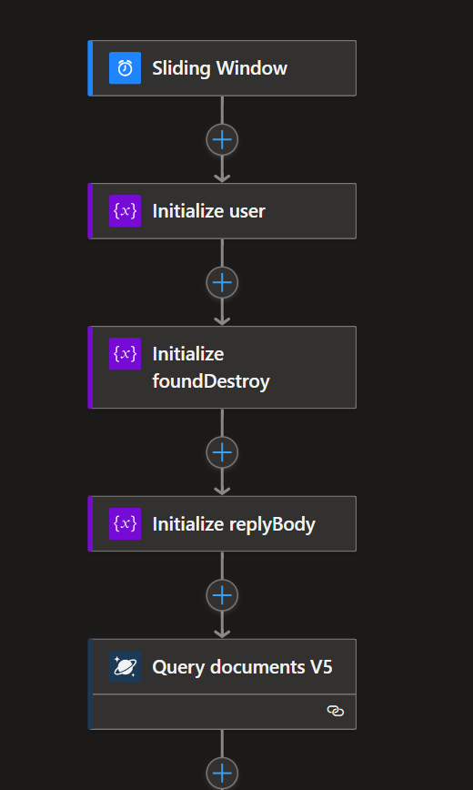
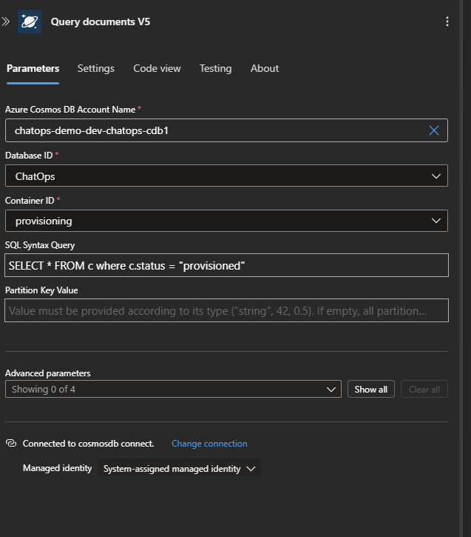
Teams Destroy Watcher Logic App
Flow – Cron trigger
Query for docs in provisioned state

Slide 51
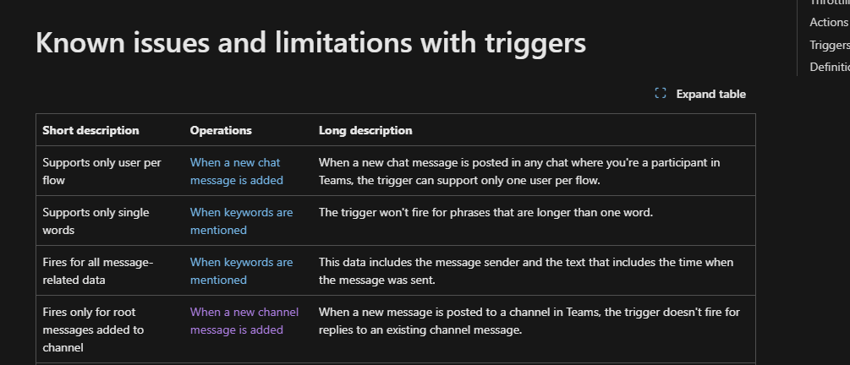
Teams Destroy Watcher Logic App
Flow – @Response case known issue

Slide 52
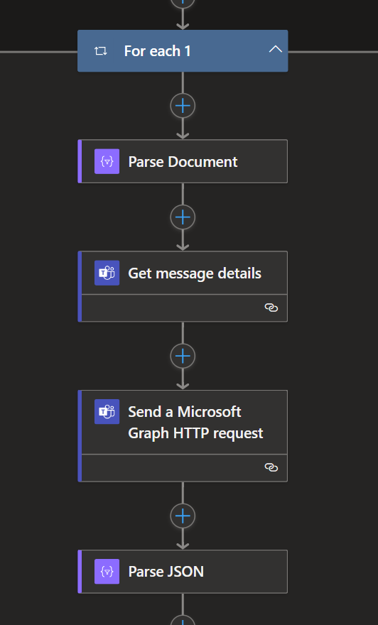
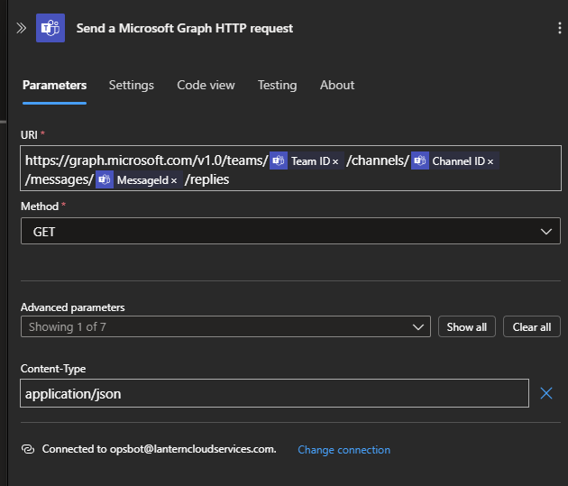
Teams Destroy Watcher Logic App
Flow – Parse each document (deployed env,)
Get message details for env.
Get replies for each message from MS Graph API
Parse reply document

Slide 53

Teams Destroy Watcher Logic App
Flow – Process each reply
Parse reply object
Identify User
Get the message body

Slide 54


Teams Destroy Watcher Logic App
Flow – Check for destroy from user

Slide 55

Teams Destroy Watcher Logic App
Flow – If true call GH deprovision
Don’t forget Bearer Token
Payload
{
"ref": "main",
"inputs": {
"message_id": "",
"user_id": "",
"msg": ""
}
}

Slide 56

Teams Destroy Watcher Logic App
Flow – Update tracking doc to “destroying” and notify user

Slide 57


Teams Destroy Responder Logic App
HTTP Trigger (copy from Provision Rsponder)
RBAC as before

Slide 58
Teams Destroy Responder Logic App
Flow – HTTP trigger
Payload
{
"status":"destroyed",
"id":"${{ inputs.message_id }}",
"user_id":"${{ inputs.user_id }}",
"resourceGroup":"chatops-demo-dev-rg-${{ inputs.message_id }}",
"messageId":"${{ inputs.message_id }}",
"msg":"${{ inputs.msg }}"
}

Slide 59

Teams Destroy Responder Logic App
Flow – Delete Tracker Doc, notify user
.tfstate management here (TODO)

Slide 60


Environmental Reaper Logic App
Cron Trigger
RBAC as before

Slide 61


Environmental Reaper Logic App
Cron Trigger
Wake up – query for deploy envs.

Slide 62

Environmental Reaper Logic App
Flow - Set Minimum delete threshold (10 min)

Slide 63


Environmental Reaper Logic App
Flow – For each env in Provisioned state, calculate min deployed
Minutes diff based on ticks
div(sub(ticks(outputs('Sample_Date1')),ticks(outputs('Sample_Date_2'))),864000000000)
100 * 100 * 100 * 60 * 60 * 24 = ticks in a day
36000000000 = ticks in hour
600000000 = ticks per min

Slide 64

Environmental Reaper Logic App
Flow – If minsDiff > minThresh

Slide 65


Environmental Reaper Logic App
Flow – Call Deprovision, notify user

Slide 66
Environmental Reaper Logic App
Flow – Reaper Callback
Deprovision will call back to deprovision responder and close workflow as with .destroy

Slide 67
Next steps
Build and Refine

